Slide 1
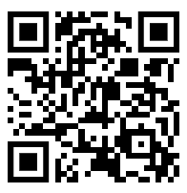

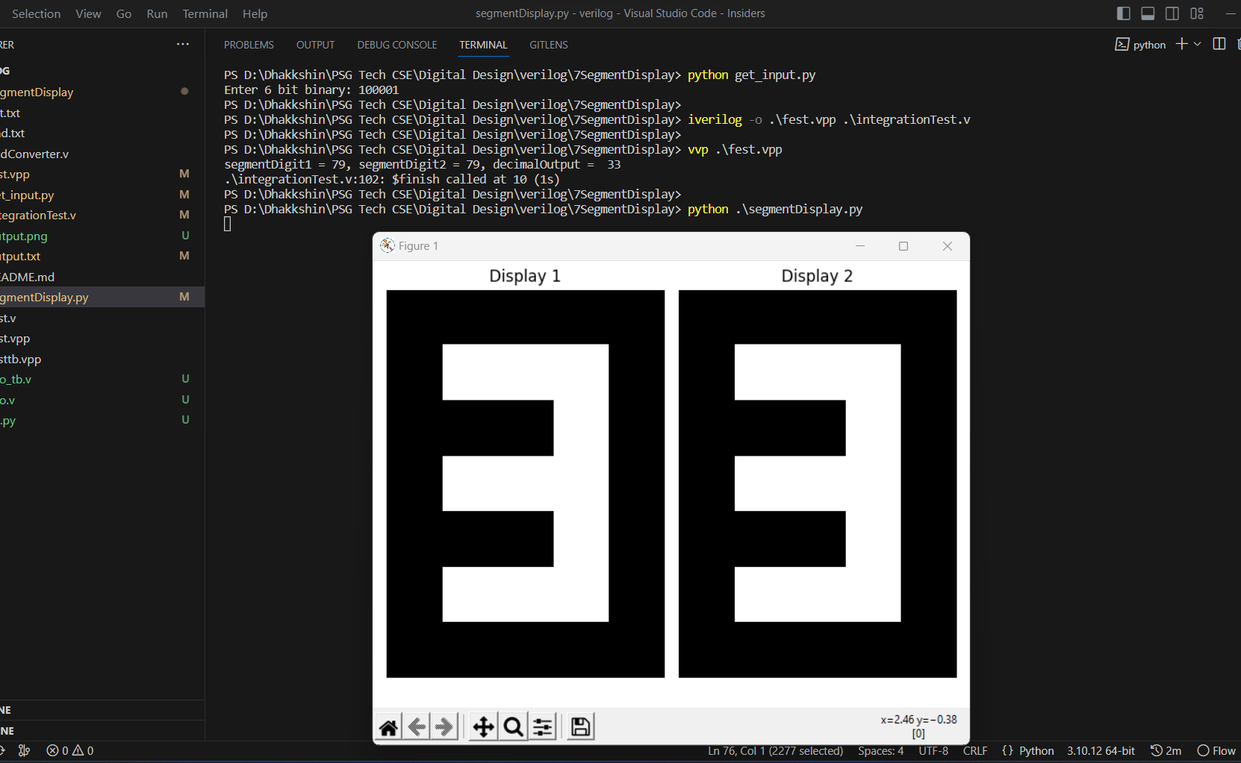
SEVEN SEGMENT DISPLAY
19z204 | Digital Design | Assignment Presentation | 19/07/23
DHAKKSHIN S R – 22Z215
KISHOREADHITH V – 22Z232
S KARTHIKEYAN – 22Z256
HARISH K – 22Z223
VISHNU BARATH K – 22Z274
https://github.com/Dhakkshin/7SegmentDisplay.git

Slide 2
INTRODUCTION
The seven-segment display has been a staple in the field of digital electronics for decades, serving as a fundamental tool for conveying numerical and alphanumeric information.
From alarm clocks to calculators, from digital signage to industrial control panels, this simple yet powerful display has found its place in numerous everyday devices.

Slide 3
SYSTEM DESCRIPTION
A seven-segment display is a type of electronic display device that can represent numbers and some characters using a combination of seven individually controllable segments. Each segment is typically composed of an LED (Light-Emitting Diode) or a set of LEDs arranged in a specific pattern .
The seven segments are labeled as A, B, C, D, E, F, and G, and together they can form the numbers 0 to 9 and some letters of the alphabet. The segments are arranged in a specific pattern to display each character.

Slide 4
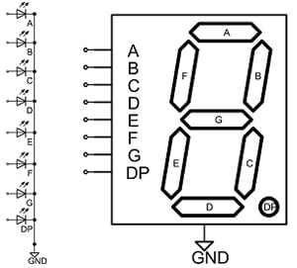
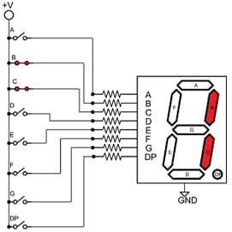
Labelling of the segments

Slide 5
DESIGN
The seven segments are usually arranged in the form of the number "8," with an additional segment in the middle to differentiate between the top and bottom parts of the digit.
To display numbers or characters on a seven-segment display, a control circuit is required. This circuit receives input signals corresponding to the desired symbol and controls the segments accordingly.

Slide 6
Each segment is connected to a pin or terminal of the display. The segments 'a' to 'g' are connected to individual pins, and each pin controls the display of each segment . The FSM design of the seven segment display is depicted below.

Slide 7
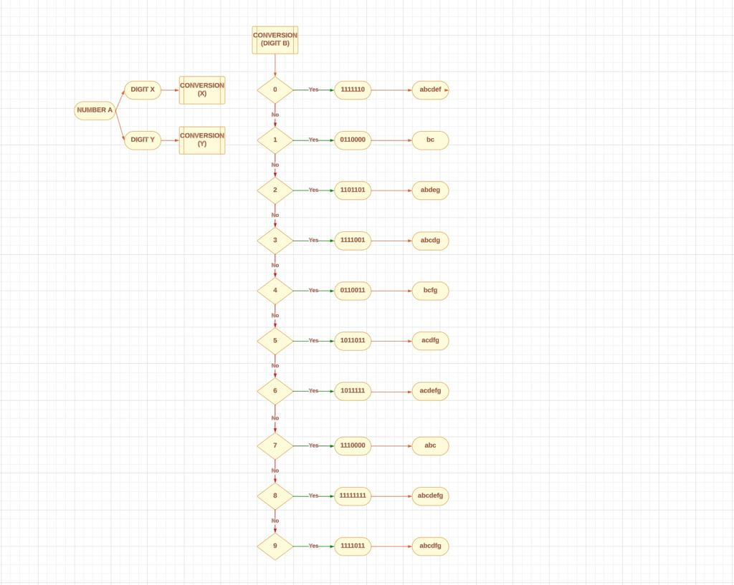

Slide 8
Block Diagram
Input from terminal - python
Python script to generate test bench
Test bench compiled using iverilog and run
Output (7 segment bits) written into a text file
7 bits read from text file and the python script generates the graphic for the display

Slide 9
TIMELINE CHART
Research about the topic
Designing the verilog system
9 July 2023
12 - 13 July 2023
2 July 2023
10 - 12 July 2023
Designing the logic for binary to 7 segment conversion
Integration of python and verilog

Slide 10
ROLE OF TEAM MEMBERS
DHAKKSHIN S R - 22Z215
KISHOREADHITH V - 22Z232
VISHNU BARATH K - 22Z274
KARTHIKEYEN S - 22Z256
HARISH K - 22Z223
: Integration of Verilog with Python
: Verilog code
: State diagram
: State diagram and Block diagram
: Testbech

Slide 11
SUMMARY
This Verilog system takes in binary and emulates the display.
This can be used in combination with other systems that require visualization of the output. Ex: alarms, calculators, scorecards

Slide 12
Tools used
Iverilog
Python (numpy)
Git and github for version control
Lucidchart

Slide 13
References
chipverify.com
javaatpoint.com
realdigital.org
chatgpt (to quickly learn the syntax)

